Slide 1
Asymmetric Loss Functions and Deep Densely Connected Networks for Highly-Imbalanced Medical Image Segmentation
Presenter: Dan Zhou

Slide 2
contribute
fully trained convolutional deep neural networks using an asymmetric similarity loss function to mitigate the issue of data imbalance and achieve much better tradeoff between precision and recall. To this end, we developed a 3D fully convolutional densely connected network(FC-DenseNet) with large overlapping image patches as input and an asymmetric similarity loss layer based on Tversky index (using Fβ scores).

Slide 3
Problem
One of the major challenges in training such image segmentation networks raises when the data are unbalanced, which is common in many medical imaging applications, such as lesion segmentation, where lesion class voxels are often much lower in numbers than non-lesion voxels.
A trained network with unbalanced data may make predictions with high precision and low recall, being severely biased toward the non-lesion class which is particularly undesired in most medical applications where false negatives are actually more important than false positives.

Slide 4
solution
1.Use asymmetric similarity loss function based on Tversky index (using Fβ scores) to mitigate the issue of data imbalance and achieve much better tradeoff between precision and recall.
2.proposed using large patches (as opposed to the whole image as input) that lead to relatively higher ratio of lesion versus non-lesion samples.

Slide 5
Model
Part one lesion segmentation method (Information retrival)
Part two asymmetric similarity loss function

Slide 6
Part one: lesion segmentation method
trained two fully convolutional neural networks with two different network architectures:
1.a 3D fully convolutional network based on the U-net architecture
2.a 3D densely connected network based on the Dense-Net architecture

Slide 7
3D U-NET Network Architecture
Input: full size image/ overlapping patches
Output: Lesion voxels are labeled as 1 and non-lesion voxels are labeled as zero.

Slide 8
3D PATCH-WISE FC-DENSENET Network Architecture
Input: overlapping patches
Output: Lesion voxels are labeled as 1 and non-lesion voxels are labeled as zero. applied sigmoid on each voxel in the last layer to form the last feature map

Slide 9
Sigmoid function
Always be used as an activation function which would map all inputs in the real number domain into the range of 0 to 1

Slide 10
Part two asymmetric similarity loss function precision and recall
Notes:
The most common effectiveness measures for information retrieval model, in information retrieval, precision and recall are two important measures that need to be taken into account when evaluate a search system.

Slide 11
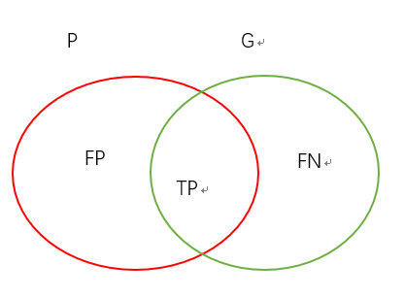
F measure
A single measure that trades off precision versus recall is the F measure
Notes:
Sometimes we want to think about precision and recall together to summarize the overall performance of the system
But the two quantities clearly trade off against one another: you can always get a recall of 1 (but very low precision) by retrieving all documents for all queries! Recall is a non-decreasing function of the number of documents retrieved.
So we use F measure as a single measure that trade off precision and recall
We hypothesize that using higher β in the asymmetric similarity loss function helps us shift the emphasis to decrease FNs and boost recall, therefore achieve better performance in terms of precision-recall tradeoff. Appropriate values of the hyper-parameter β can be deﬁned based on class imbalance ratios.

Slide 12
Part two asymmetric similarity loss function
To deﬁne the Fβ loss function we use the following formulation:
gradient vector can be calculated as:
$$\frac{\left(1+β^{2})\sum_{i=1}^{N}{p_{i}g_{i}}\right.}{\left(1+β^{2})\sum_{i=1}^{N}{p_{i}g_{i}}+β^{2}\sum_{i=1}^{N}{\left(1−p_{i})g_{i}+\sum_{i=1}^{N}{\left.p_{i}(1−g_{i}\right)}\right.}\right.}$$
$$\frac{∂F_{β}}{∂p_{i}}$$
$$\frac{\left(1+β^{2})g_{j}(β^{2}\sum_{i=1}^{N}{\left(1−p_{i})g_{i}+\sum_{i=1}^{N}{\left.p_{i}(1−g_{i}\right)}\right.}\right)}{\left(1+β^{2})\sum_{i=1}^{N}{p_{i}g_{i}}+β^{2}{\sum_{i=1}^{N}{\left(1−p_{i})g_{i}+\sum_{i=1}^{N}{\left.p_{i}(1−g_{i}\right)}\right.}}^{2}\right.}$$
Notes:
the pi is the probability of voxel i be a lesion and 1−pi is the probability of voxelibeanon-lesion.Additionally,thegroundtruthtraining label gi is 1 for a lesion voxel and 0 for a non-lesion voxel.
each element of gradient vector can be calculated as:
by adjusting the hyperparameter β wecancontrolthetrade-offbetweenprecisionand recall

Slide 13
DATASETS
trained and evaluated our networks on data sets from the MS lesion segmentation (MSSEG) challenge of the 2016 Medical Image Computing and Computer Assisted Intervention conference (https://portal.fli-iam.irisa.fr/msseg-challenge/overview)
as well as the longitudinal MS lesion segmentation challenge of the IEEE International Symposiumon Biomedical Imaging(ISBI)conference [18] (https://smart-stats-tools.org/lesion-challenge)

Slide 14
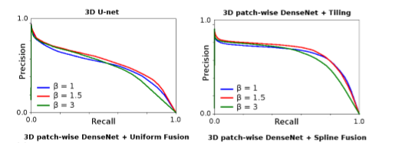
Result metrics used for evaluation
This includes the Dice Similarity Coefficient(DSC), F2, APR score
Notes:
To critically evaluate the performance of lesion segmentation for the highly unbalanced (skewed) datasets, we use the Precision-Recall (PR) curve (as opposed to the receiveroperator characteristic, or ROC, curve) as well as the area under the PR curve (the APR score)

Slide 15
Result
according to all combined test measures (i.e. DSC, F2, and APR score), the best results were obtained from the FCNs trained with β =1.5

Slide 16
High density of lesions
Notes:
show the effect of different hyperparameter (β) values on segmenting a subject with high density of lesions, medium density of lesions and a subject with very few lesions, respectively.

Slide 17
Medium density of lesions

Slide 18
Low density of lesions

Slide 19
Thank You

